Slide 1
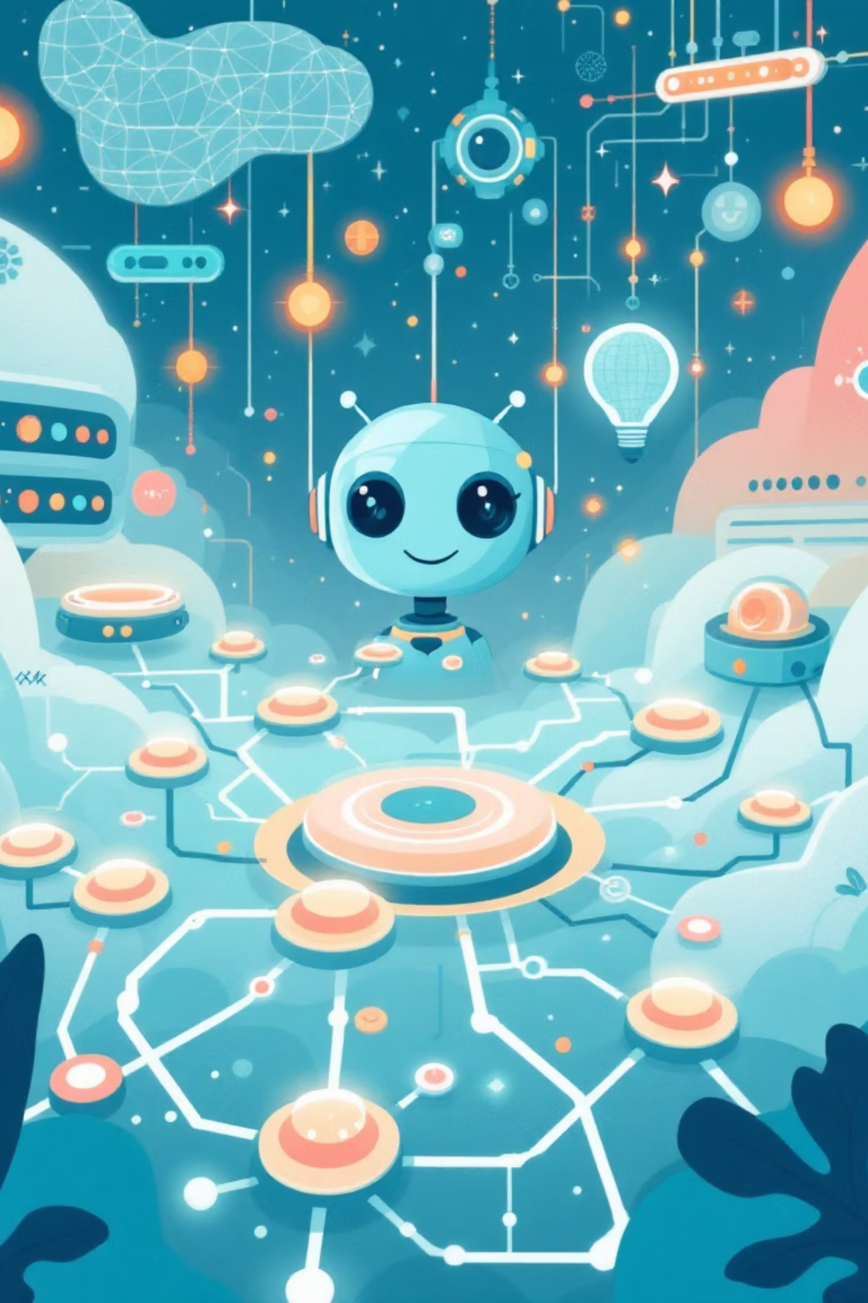
Agent NEXUS, LUMINA & HELIX
Transforming SDLC with Intelligent AI Agents

Slide 2

The Challenge We Face Today
Our developers spend countless hours on repetitive, manual tasks that drain productivity and creativity. From sifting through application logs to translating requirements into tickets, these time-consuming activities prevent our team from focusing on what truly matters: innovative problem-solving and building exceptional software.
It's time to reimagine our SDLC process with intelligent automation that empowers developers rather than burdening them.

Slide 3



Our Vision: Three Agents, One Seamless Workflow
We're building an intelligent agent ecosystem that transforms manual SDLC tasks into automated, efficient processes. Each agent specializes in a critical phase while working together harmoniously.
Agent NEXUS
Agent LUMINA
Agent HELIX
Log Analysis & Issue Detection Expert
Requirements Interpretation Specialist
Development Lifecycle Orchestrator

Slide 4
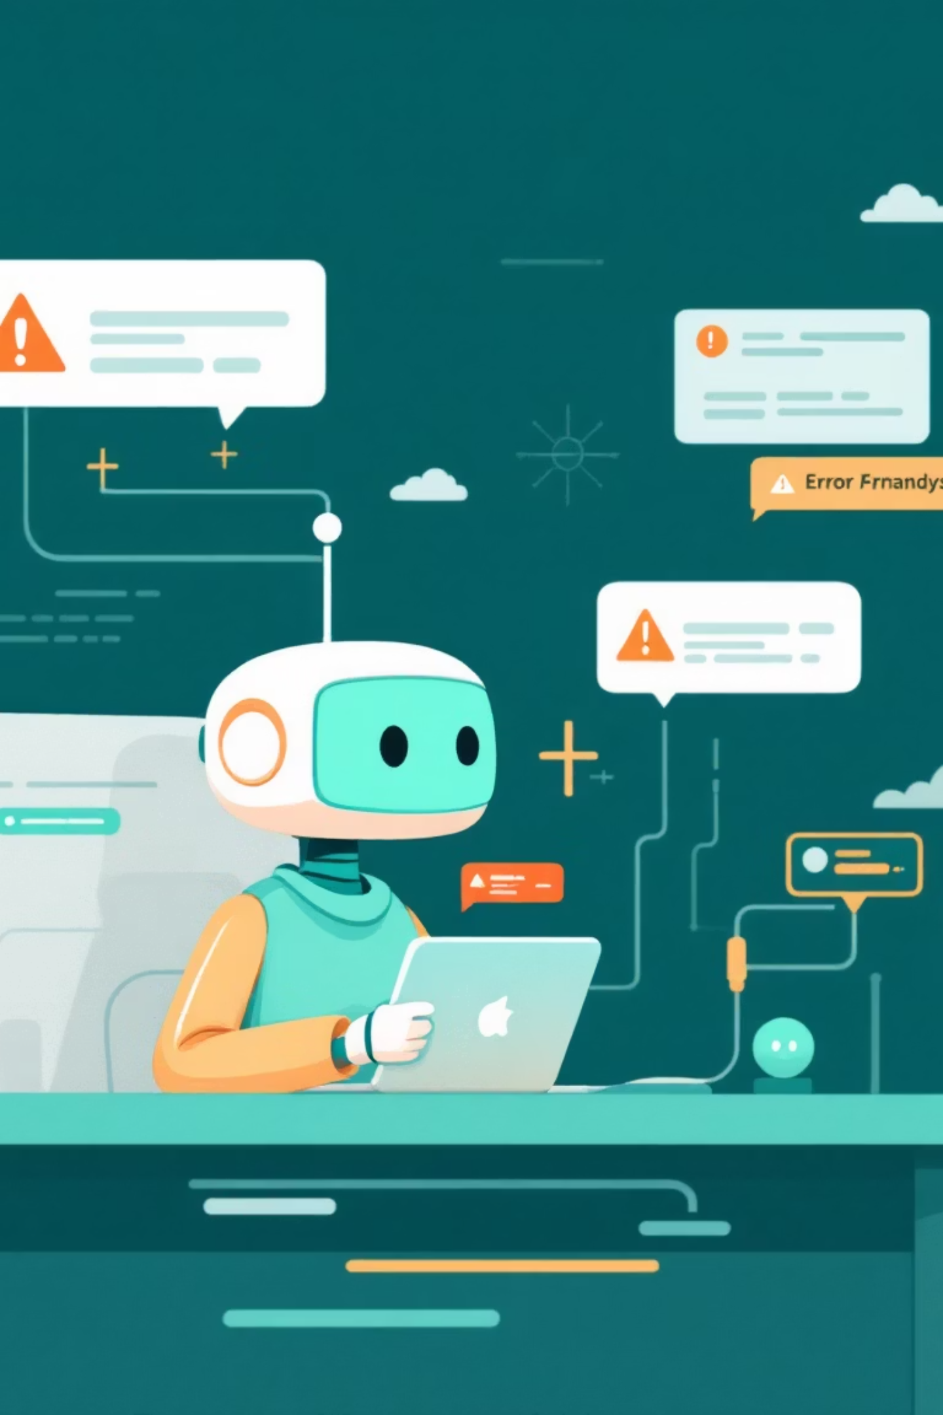




Agent NEXUS: Your Log Analysis Expert
NEXUS continuously monitors application logs, identifying errors, warnings, and anomalies with intelligent pattern recognition. It assigns severity ratings to each issue and creates properly formatted JIRA tickets after quick user approval.
Scan Logs
Automated analysis of application logs
Detect Issues
Identify and rate problems
Create Tickets
Generate JIRA tasks with approval
Notify Teams
Real-time updates via Teams

Slide 5
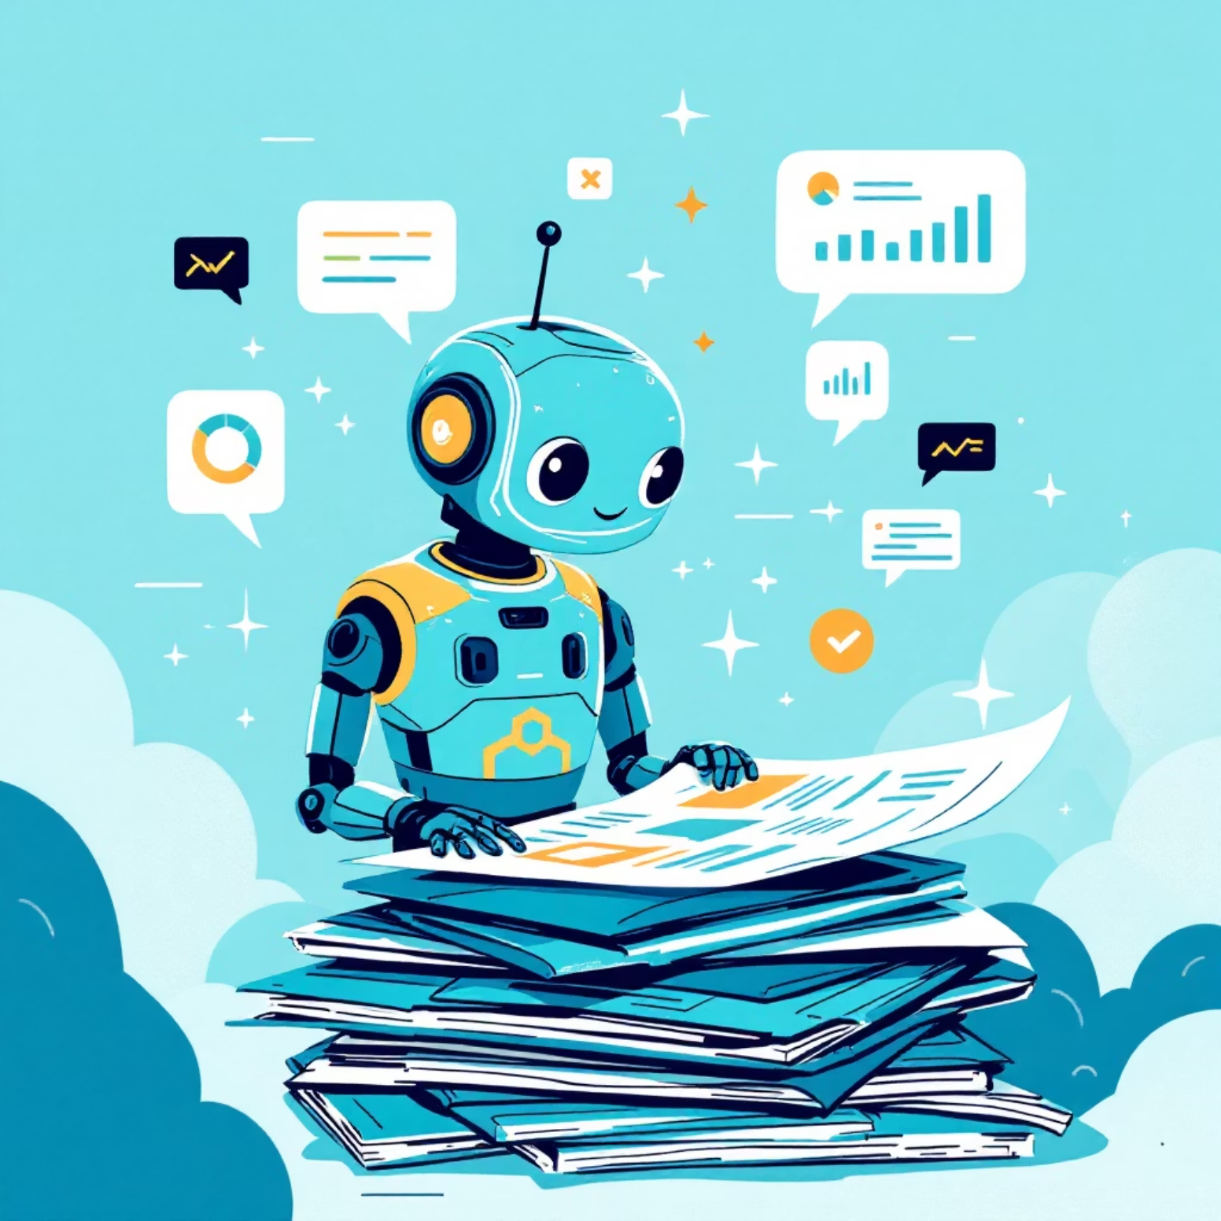
Agent LUMINA: Requirements Interpretation
LUMINA intelligently reads Confluence documentation and extracts actionable business requirements and acceptance criteria. It transforms scattered information into structured JIRA tickets, ensuring nothing gets lost in translation.
After user review and approval, LUMINA seamlessly hands off tickets to Agent HELIX for implementation while maintaining full transparency through Teams notifications.
01
02
Parse Confluence Pages
Extract Requirements & Criteria
03
04
Generate Structured Tickets
Route to Agent HELIX

Slide 6
Agent HELIX: The Development Powerhouse
HELIX orchestrates the complete software delivery lifecycle with unprecedented intelligence and automation. From requirements to deployment, it handles everything developers need to ship quality code faster.
1
Requirements Extraction
Pulls requirements from JIRA and defines comprehensive test cases
2
Branch Creation & TDD
Creates GitHub feature branches and implements Test-Driven Development recursively
3
Code & Infrastructure
Develops application code, unit tests, automation tests, and AWS Terraform infrastructure
4
Quality Enforcement
Ensures >90% test coverage, follows commit guidelines, manages PR workflows
5
Continuous Integration
Automatically addresses feedback through AI and human review loops until merge-ready

Slide 7
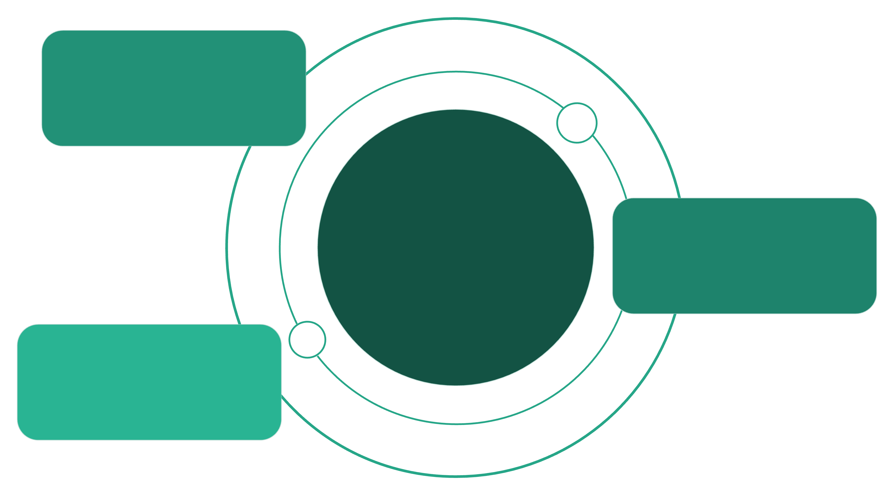
System Architecture
NEXUS Agent
Reads logs and creates JIRA tickets
Teams Hub
LUMINA Agent
Central notifications and workflow orchestration
Integrates Confluence and creates JIRA tickets
HELIX Agent
Aggregates tickets, manages GitHub and AWS
Our agent ecosystem integrates seamlessly with existing tools: Application Logs, Confluence, JIRA, GitHub, AWS, and Microsoft Teams. Each agent communicates through well-defined interfaces, ensuring transparency and collaboration at every step.

Slide 8


Expected Impact: Measurable Results
Time Savings
Quality Improvements
90%
Test Coverage
50-60%
Across all projects
60%
Issue Reduction
Fewer production problems
Log Analysis
Reduction in time spent
30-35%
Requirements
Faster processing
50-60%
Development
Quicker cycles

Slide 9




Beyond Speed: Strategic Benefits
100% Standards Compliance
Perfect Documentation Alignment
Automatic adherence to JIRA ticket standards and conventional commit guidelines ensures consistency across all projects and teams.
Requirements from Confluence translate directly into code implementation with full traceability and zero information loss.
Growing Knowledge Base
Elevated Code Quality
Automatic tracking of problem management tasks builds institutional knowledge, enabling continuous improvement and pattern recognition.
Enforced testing standards and automated reviews ensure production-ready code with significantly reduced technical debt.

Slide 10


The Future of SDLC Starts Now
Empower developers to focus on innovation while AI handles the repetitive work.
Our three-agent system transforms SDLC from a manual, time-consuming process into an intelligent, automated workflow. With NEXUS, LUMINA, and HELIX working together, we're not just building software faster—we're building it better.

